Slide 1
Community for Emerging and Zoonotic Diseases
Identifying emerging risks through collective intelligence
CEZD – CAHSS Bovine Network Update
11 October 2024
www.cezd.ca

Slide 2
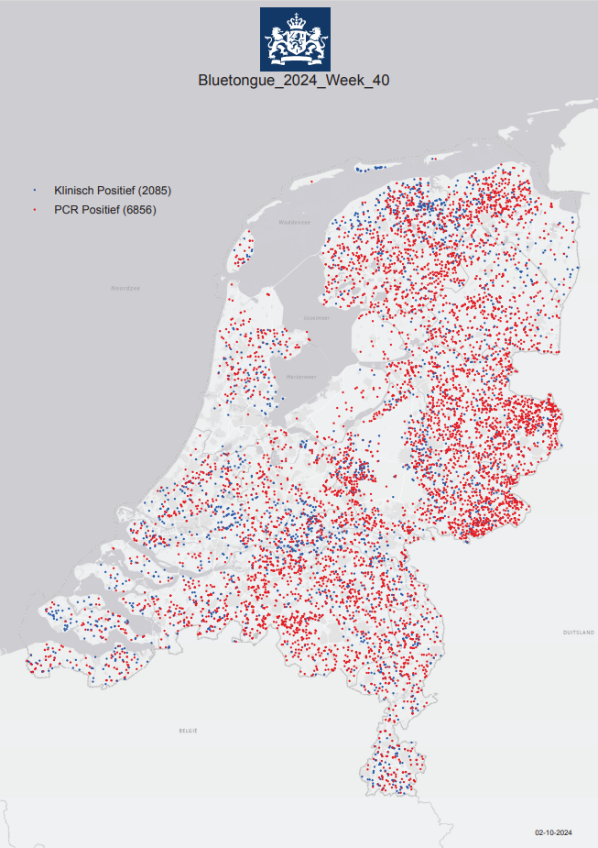
Bluetongue virus (BTV-3) in Europe
Netherlands
First reported Sept 5, 2023
Most recent reports
  PCR BTV-3 positives – 6856
  Clinically positive - 2085 (no PCR)
  Spread through entire country, all 12 provinces
Cases in cattle and sheep
Two vaccines for BTV-3 now available
  Spanish and German
The impact of the bluetongue serotype 3 outbreak on sheep and goat mortality in the Netherlands in 2023
Notes:
Netherlands first reported the outbreak of BTV-3 in Sept 2023
For 2024, as of October 2, recent counts show 2085 clinically positive and 6856 PCR positive cases (Totaling to ~ 9000 cases)
Cases have been reported in both cattle and sheep, earlier cases also reported one in a dog and some in alpacas/lamas
Two vaccines are available - one is Spanish and the other German
However even with the vaccination still appears to be spreading.
There is also a recent journal article published on the impact BTV-3 has had on sheep and goat mortality in the Netherlands. Linked in slide.
Moving on to other European countries that have reported BTV-3 outbreaks

Slide 3
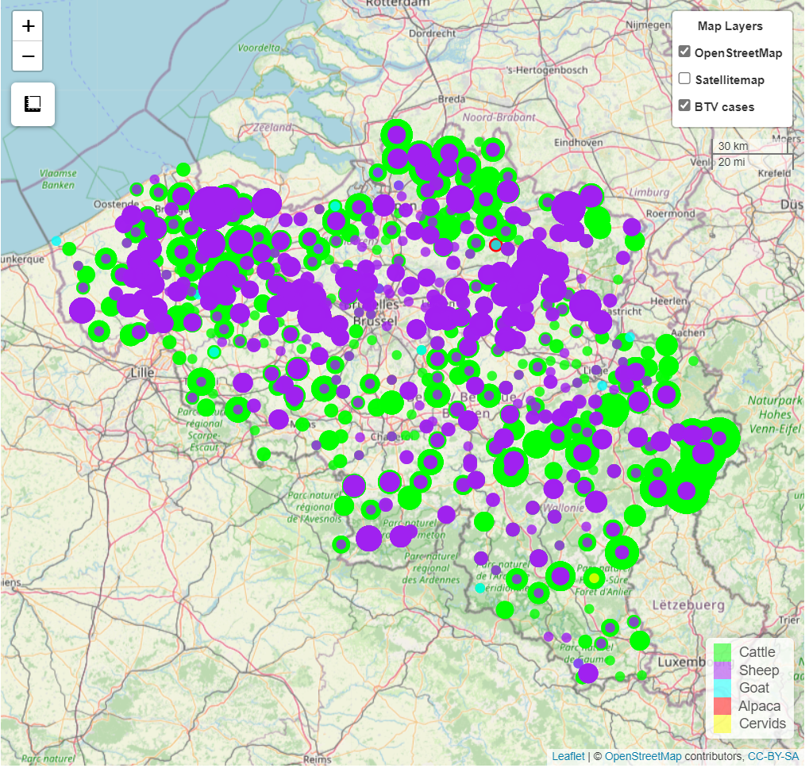
Bluetongue virus (BTV-3) in Europe
Belgium
October 10, 2023 case of BTV-3 in sheep in Merksplas
Dashboard now shows cases across entire country
~1,192 farms affected now, ~3x more than three weeks ago
Germany
Oct 13, 2023 cases of BTV serotype 3 in Kleve
Cases in both cattle and sheep
93 outbreaks reported to WOAH, news media suggest widespread across entire country (with Berlin reporting cases now as well)
Notes:
Belgium had reported 1 additional case in late April 2024 for a total of 8, but now looking at their dashboard, it seems that cases are reported across the entire country. Recent media reports suggest there are 1,192 farms affected (which is 3 times more than what was reported ~3 weeks prior)
Germany has reported additional cases in both cattle and sheep, but totals differ across different reporting systems. There have not been many WOAH/WAHIS reports, but news media suggests it is widespread across the country, with only the state of Berlin currently unaffected.

Slide 4
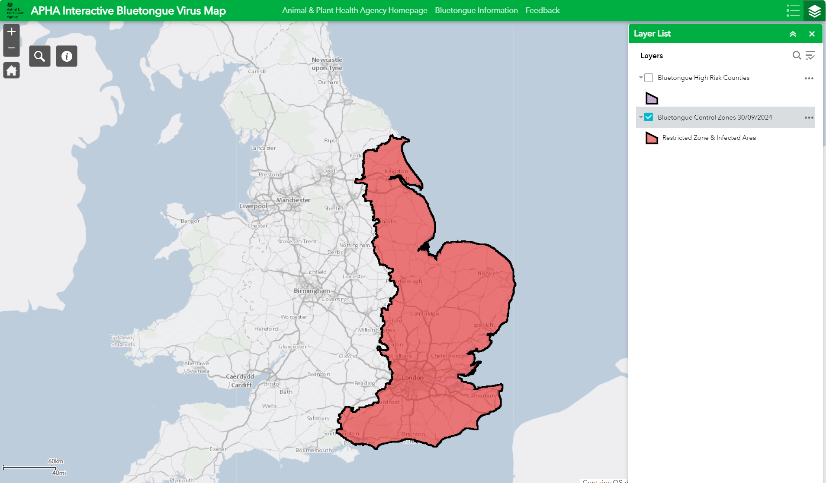
Bluetongue virus (BTV-3) in Europe (*new country)
UK
Nov 10, 2023 cases of BTV serotype 3 in cattle in Kent
Reoccurrence in late August 2024
As of October 2, 115 total cases in England and Wales
France *
First case on July 30, 2024
Most recent WOAH report shows 209 outbreaks in both sheep and cattle
Vaccine distribution planned, 6.4 million doses
UK Interactive BTV Map
Notes:
UK:
Last update we discussed the UK Risk assessment that looked at the incursion of both BTV-3 and BTV-8 into the country. The UK has reported cases of BTV-3 in 2023, but seemed to have gotten it under control through the winter.
One of their conclusions was - a very high probability of a new introduction of BTV-3 into livestock into great Britain through infected midges being blown over from northern Europe – however with a high uncertainty.
The UK has now reported a reoccurrence of the virus, as of September 8, 2024 there are a total of 115 affected premises mainly across England, with a few cases in Wales, and three vaccines have been given special permission for use under licence in the UK
The map on the right links to the UK dashboard for BTV cases along with the established zones.
France:
Since the initial reports of BTV-3 in France in late July 2023, the country has reported a total of 209 outbreaks of BTV-3 in both sheep and cattle, the outbreaks are still localized to north eastern France, along France’s borders with Belgium and Luxembourg, however they are moving southwards
France is distributing 6.4 million doses of BTV-3 vaccine to the most impacted regions

Slide 5
Bluetongue virus (BTV-3) in Europe (*new country)
Luxembourg*
First case August 2, 2024
As of October 9, 1,193 animals across 445 farms in Luxembourg are currently infected
Vaccination underway since August 9, 2024
Denmark*
First cases of BTV-3 confirmed August 9 2024
  Sheep flock in Tonder
  Establishment also held cattle but no symptoms so far
Total outbreaks now at 164
Switzerland*
First cases of BTV-3 August 28/29 2024
  Three cases (one sheep in Solothurn and two sheep on a farm in Jura)
  Currently no approved vaccine against BTV-3 in Switzerland
As of October 9, total # outbreaks is 958
Norway*
Initial reported August 21, 2024
  Two sheep in Kristiansand (southern Norway)
  blown in from Denmark?
As of October 7, total # outbreaks 47
Notes:
Shortly after the initial France reports, Luxembourg reported its first outbreak of BTV-3. Since the initial detection on August 2, 2024, a total of 1,193 animals (1,042 cattle, 141 sheep, 8 goats, and 2 alpacas) have tested positive for BTV-3 across 445 farms. A vaccination campaign was initiated on August 9, 2024, with 50,000 doses distributed to veterinarians and another 190,000 additional doses ordered.
Denmark first cases of BTV-3 were reported in a sheep flock in Tonder, which also held cattle (not clinical). BTV-3 was confirmed on 9th August 2024. Current total of outbreaks reported in Denmark is 164 – which is now in line with media reports that have suggested its widespread across the country.
Switzerland has also recently reported their first case of BTV-8 in one cattle in Vaud. There in currently no approved vaccine for BTV-3 in Switzerland. As of Oct 9, there have been 958 outbreaks reported.
Norway has also reported its first occurrences of BTV-3 in sheep in Kristiansand (southern Norway) which could have been blown over from Denmark. As of Oct 7, there have been 47 outbreaks reported mostly still localized to southern Norway.

Slide 6
Bluetongue virus (BTV-3) in Europe (*new country)
Czech Republic*
September 4/5 2024, two initial outbreaks close to the German border
Total # of outbreaks now is 3
Austria*
One case reported on September 13, 2024, in cattle
Total # of outbreaks now is 17
Close to borders of Switzerland and Germany
Portugal*
September 11, initial report in sheep in Evora
Sweden
Reoccurrence of BTV-3, last report in 2009
  Two cases now reported in cattle in the south of the country
  As of October 1, total # outbreaks is 70
  From Denmark?
Greece*
  September 18, initial reports
  Total # outbreaks now is 10, all in the north close to border with Bulgaria
Spain*
Not yet reported to WOAH, September 30, first occurrences reported in two provinces
Notes:
On September 4/5 Cezch Republic confirmed its first occurrences of BTV-3. One case in a Ram, and four cases in sheep, close to the German border. As of October 9, there have only been 3 outbreaks reported to WOAH (all close to the border with Germany)
Austria has also reported its first case of BTV-3, one case was reported on September 13, with a start date of Sept 10, in cattle in Bergenz. Total number of outbreaks now is 17, all still close to the borders of Switzerland and Germany.
Portugal reported its initial report in sheep in Evora on September 11th.
Sweden reported cases of BTV-3 on September 13th . A reoccurrence of the virus, which was previously reported in February 2009. Two cases were reported in the south of Sweden, one in dairy cattle and the other in beef cattle. As of October 1, 70 outbreaks have been reported in the country. Similarly to Norway - could it have again blown over from Denmark?
Greece reported its initial cases on September 18th, total number of outbreaks now is 10, all of which are in the north close to the border with Bulgaria.
And finally, at the end of September 2024, Spain reported its first occurrences of BTV-3 – still not reported to WOAH; two cases were reported in the province of Badajoz and a third in Huelva. The country has ordered ~175,000 doses of the BTV-3 vaccine
There has been a lot of BTV-3 activity in Europe lately, with ~10 countries now reporting first instances of the virus, and Sweden and the UK reporting reoccurrences. Hopefully with some of the vaccination efforts as well as the upcoming cold weather it will decrease.

Slide 7
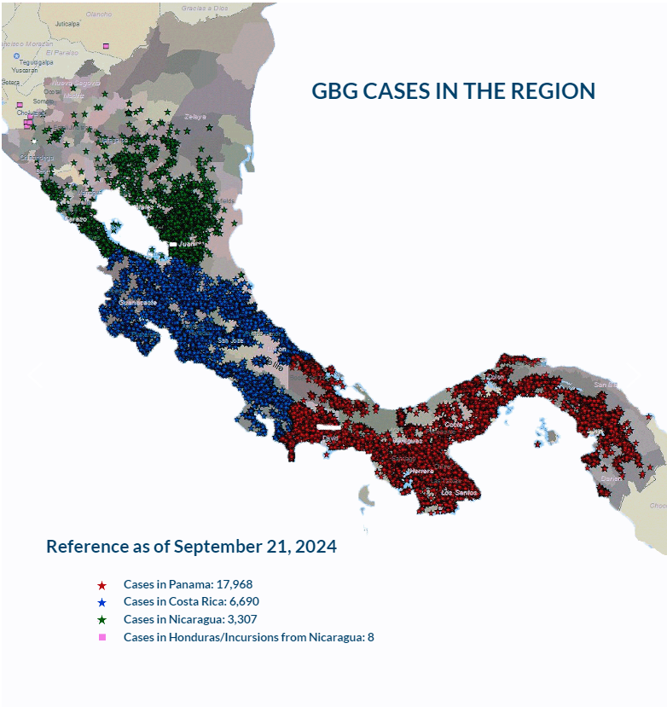
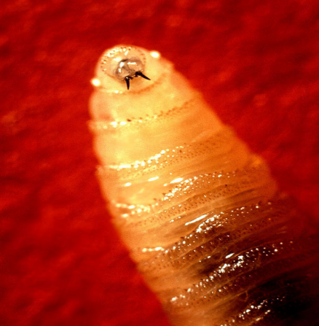
New World Screwworm in Central America
Parasitic fly larva - Cochliomyia hominivorax causing wound myiasis
February 2024 – Costa Rica declared a sanitary emergency
March 2024 – Costa Rica reported 1st human case
As of Sept 21, 2024, according to COPEG:
  Panama – 17,968 cases
  Costa Rica – 6,690 cases
  Nicaragua – 3,307 cases
Honduras reported 8* cases (equine? cattle?)
Oct 2, 2024 – Costa Rica reported 25 human cases
Oct 2, 2024 – Panama reported 79 human cases
Sept 9, 2024 – Nicaragua reported at least 2 human cases
Increase in cases may be due to more aggressive fly as well as increased rainfall
Mexico is strengthening preparedness/control efforts
COPEG
Notes:
Now for the New world Screwworm, it has been spreading through central America, moving north from Panama to Costa Rica to Niaragua, and most recent reoccurrence in Honduras
In Feb 2024 – Costa Rica declared a sanitary emergency due the presence of the screwworm, and then in March 2024 they reported their first human case.
As of September 21, 2024:
Panama has reported 17,968 cases
Costa Rica – 6,690 cases
Nicaragua – 3,307 cases
Honduras = 8 equine
Note Copeg cases – unsure if this include human cases along with the animal cases or just the animal cases.
As of July 29, 2024 Costa Rica has reported 22 human cases and Panama has reported 79 human cases (age range from 1 year to 95 years).
Nicaragua, as of Sept 9, reported its first two human cases of the Screwworm.
Honduras recently reported 3 cases in illegally imported equines (unclear of specific species), very close to the border of Nicaragua. Copeg mentions 8 cases and another sources mentions it was in cattle. So unclear if its equine or cattle or both, but what is known is that the fly has made its way into Honduras.
The increase in cases in Costa Rica may be due to a more aggressive strain of fly, that moves faster and prefers to mate with field flies (as opposed to sterile flies), which has reduced the effectiveness of the sterile fly control program.
Increased rainfall has also been implicated as it may lead to may parasitic activity.
There is also concern for wildlife (deer, wild boar, coyotes…) in these countries, but due to their habitats its hard to determine the exact number of animals affected. Recently Costa rica reported an infestation in a sloth.
Mexico is providing Central American nations with over 90,000 packets of larvicides and wound-healing powders to support containment efforts. SENASICA is also working with local producers to ensure timely treatment of livestock wounds and monitor animal movement from Mexico’s southern border.

Slide 8
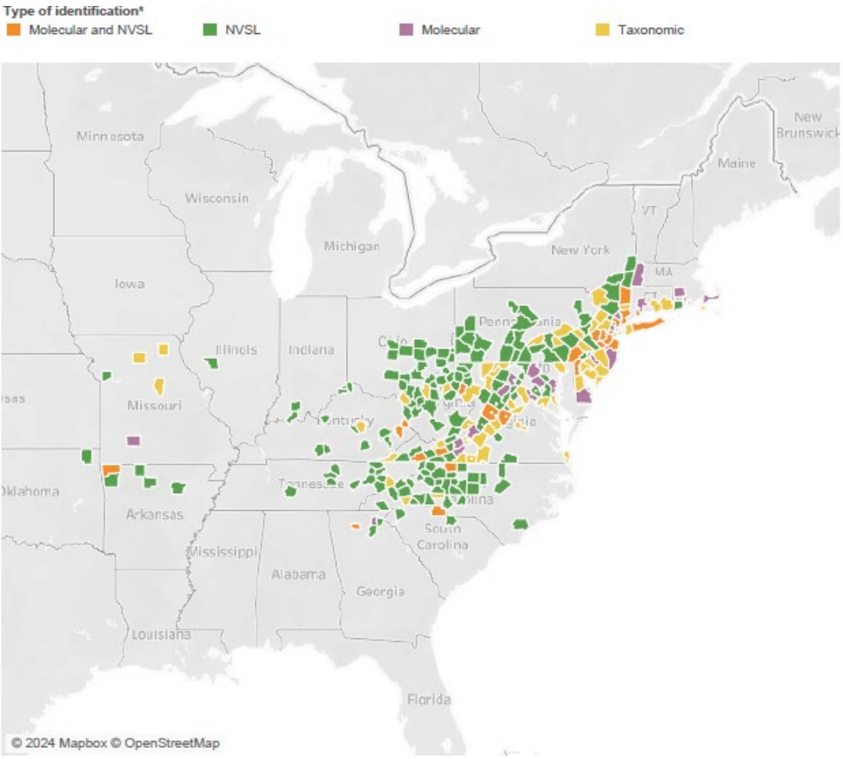
Longhorn Tick and Theileriosis in the USA
Oklahoma – new state reporting finding the ALHT
  Originally reported as Mayes County, but that’s where the office it, pasture is in Craig County
  July 31, 2024 – 13 female ticks collected from 22 cows that were off loaded at a barn in Missouri, all ticks were engorged
R. rickettsi has been found in a field collected tick in New Jersey
Haemaphysalis longicornis (Acari: Ixodidae) does not transmit Babesia bovis, a causative agent of cattle fever
USDA Haemaphysalis longicornis (Asian longhorned tick) Situation Report
Notes:
Oklahoma now the 21st state to report the ALHT.
R.Rickettis has been found in a field collected tick from New Jersey (they has tested 187 pools, 1248 ticks – 1 tick was positive for R. rickettsia)
Also a recent finding that the LHT does not transmit Babesia bovis

Slide 9
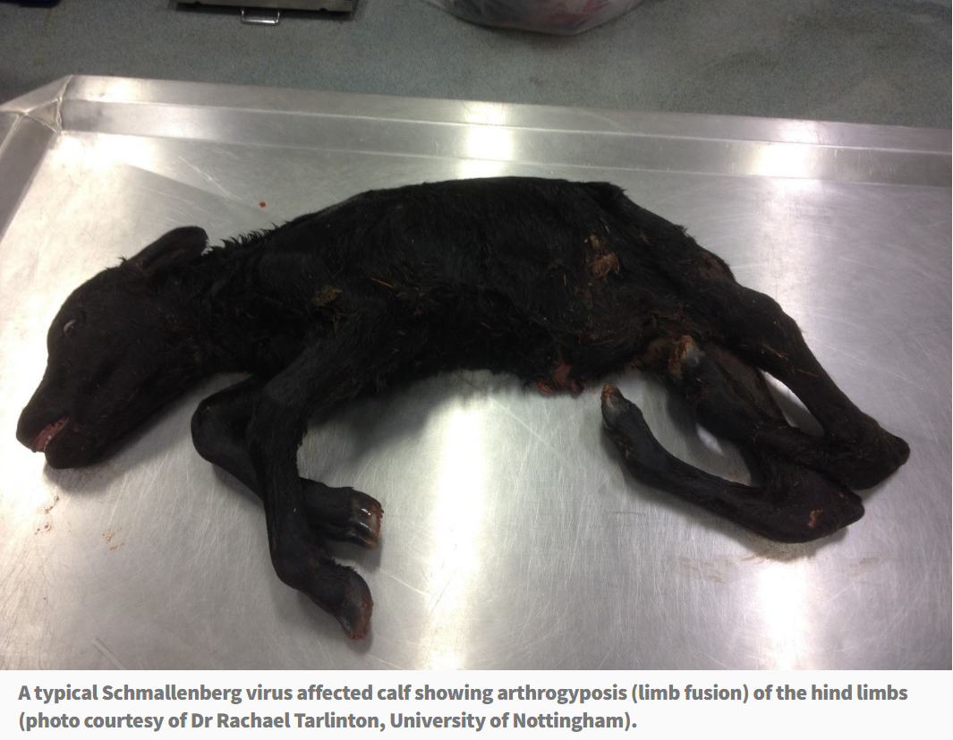
Schmallenberg virus in Ireland
October 2024
Positive antibodies to SBV detected in some Irish dairy herds
Milk drop syndrome reported in diary herds over the summer
AHS - Current News (agriculture.gov.ie)
Notes:
We had one signal on Schmallenberg virus in Ireland -
The virus is spread by culicoides – In cattle SBV is associated with fever, milk drop, diarrhoea, as well as abortion and deformed foetuses. In sheep and goats, it is known to cause abortion and deformed lambs.
The first case of Schmallenberg was diagnosed in Ireland in October 2012, and over the following five months , the virus was detected directly in 49 cattle holdings and 30 sheep holdings. However, as the condition is not notifiable, likely many more cases were never taken to a laboratory for confirmation and were therefore undetected.
Most recently – October 2nd article, the virus itself was detected or very recent infection diagnosed using paired serology around the same time clinical signs occurred. Milk drop syndrome was reported in the dairy herds over the summer.

Slide 10
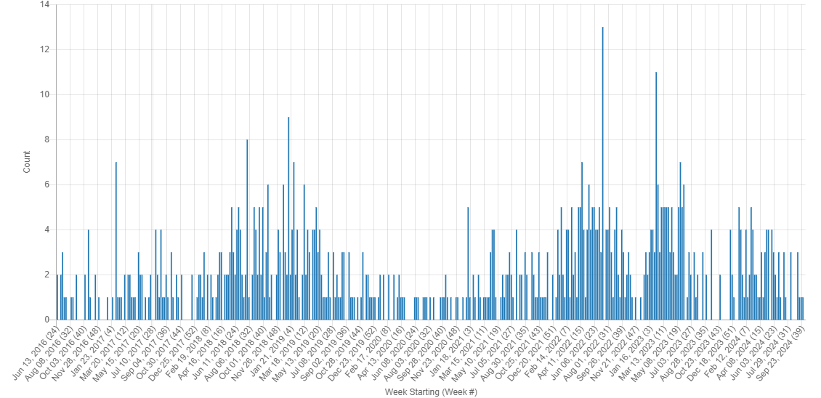
Foot and Mouth Disease
Countries reporting FMD outbreaks: Turkiye(A), South Africa(SAT3), Mozambique(SAT1), India, and Vietnam
Scientific Finding: Multiple incursions of foot-and-mouth disease virus serotype O into the Republic of Korea between 2010 and 2019
KIWI FMD Signals June 2016 - October 2024
Notes:
A few countries (5) have reported outbreaks of FMD over the past few months. So we have Turkiye, South Africa, India, Mozambique and Vietnam. Some reporting the type (ie. A, SAT1-3) and some unspecified. Whats interesting is the recent WOAH report from Turkiye (type A) which indicates that: the virus is thought to have been mechanically transmitted by birds due to the weak biosecurity level in the farms and large number of sunflower and corn fields in the region, as thousands of starlings invade the fattening farms in the evening. And then that the spread of the disease within the village is due to the common use of pastures.
There was is a scientific finding on FMD type O in South Korea linked below as well as our signal frequency chart.

Slide 11
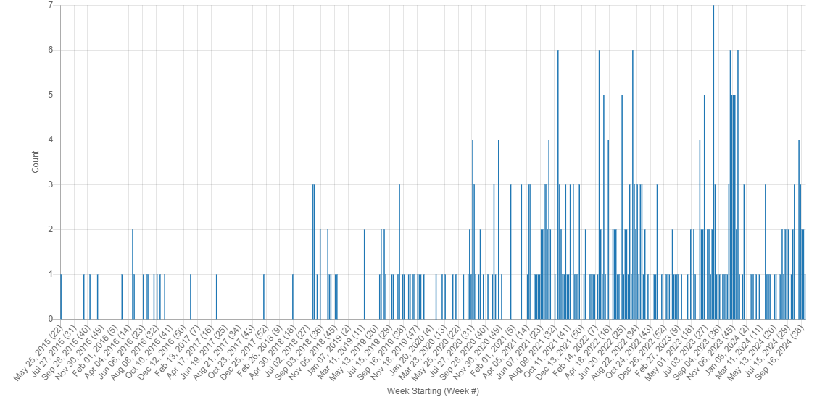
Lumpy Skin Disease
Countries that have reported cases of LSD:
South Korea – recurrence Aug 2024, total # of outbreaks 8
Algeria – now reported to WOAH – 10 outbreaks in the north of the country
Others: India, Namibia, Libya, Thailand, Tunisia, Bangladesh, Taiwan
KIWI LSD Signals May 2015 - October 2024
Notes:
South Korea has reported a recurrence of LSD at the end of August 2024, as the previous outbreaks resolved in December 2023. So far they have reported 8 outbreaks of LSD across the country with 60 animals affected and 670 susceptible. The most recent outbreak was reported on October 4th.
Algeria has now reported some outbreaks of LSD to WOAH – in the system it displays ten outbreaks in the north of the country.
Other countries reporting outbreaks of LSD over the past few months include: India, Namibia, Libya, Thailand, Tunisia, Bangladesh, and Taiwan.

Slide 12
Scientific Findings
Case Report: A Sporadic Bovine Papular Stomatitis Virus Infection In Dairy Calves In South Taiwan
Arthropod-Borne Viruses of Human and Animal Importance: Overwintering in Temperate Regions of Europe during an Era of Climate Change
Notes:
A few unrelated scientific findings

